Slide 1
Modelling with Lasso and Random Forest
NUS Lecture
Minh Nguyen

Slide 2

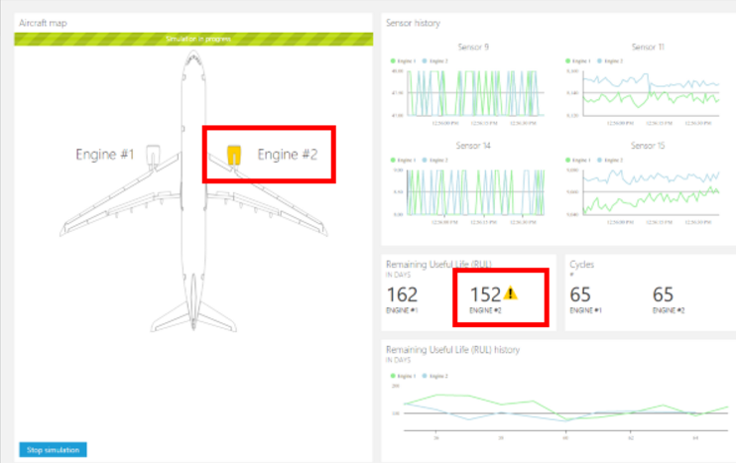
Purposes of Data Modelling
Inference
Explain the relationship among predictors and between predictors and responses.
Tell data insights and trigger investigation
Prediction
Estimate responses given predictor values in a set of unobserved samples.

Slide 3
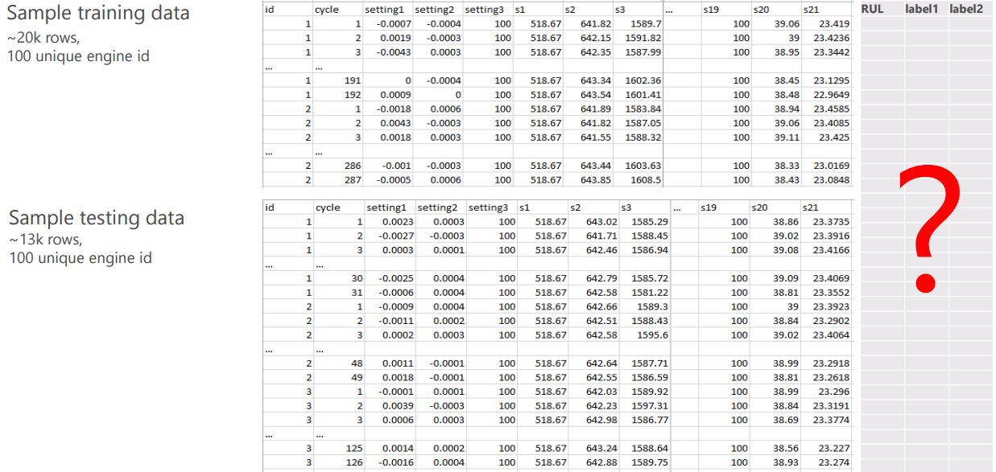
Data Structure

Slide 4
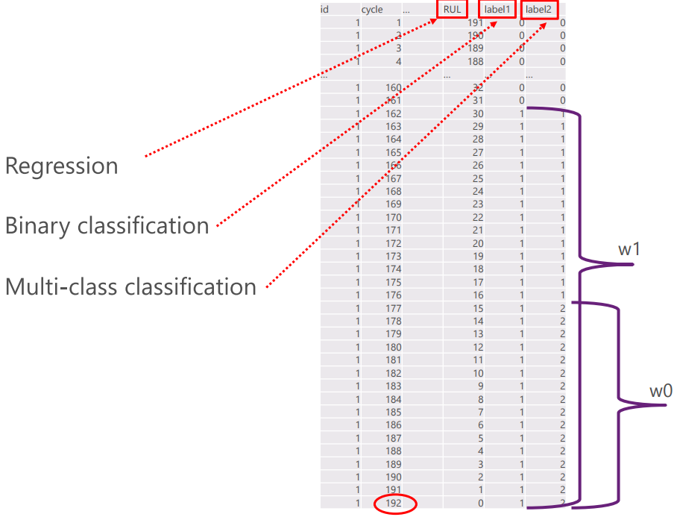

Data Structure
$$y=f(X)$$

Slide 5
1. LASSO

Slide 6




Basic Model Assumptions
Differences
One true model vs a distribution of models.
Prediction: one model vs integral model
Two approaches to estimate $f$
Underlying model style (*)
Bayesian style
$$y=f(X)$$
Test error
$$y=f^{∗}(x)$$
$$y=\sum_{k=0}^{n}{{π_{i}f}_{i}^{∗}(x)}$$
Model complexity
Ref: Chapter 5. Deep Learning. Ian Goodfellow, Yoshua Bengio and Aaron Courville

Slide 7
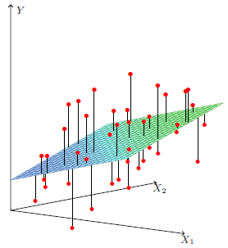

Linear Regression
Assumption: $f\left(X\right)=B_{0}+\sum_{j=1}^{p}{X_{j}B_{j}}$
To find B
$J_{B}={\left(y−XB\right)}^{T}(y−XB)$
$\frac{∂J_{B}}{∂B}=−2X^{T}(y−XB)$
$\hat{B}={\left(X^{T}X\right)}^{−1}X^{T}y$

Slide 8
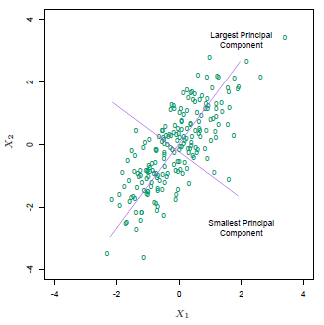
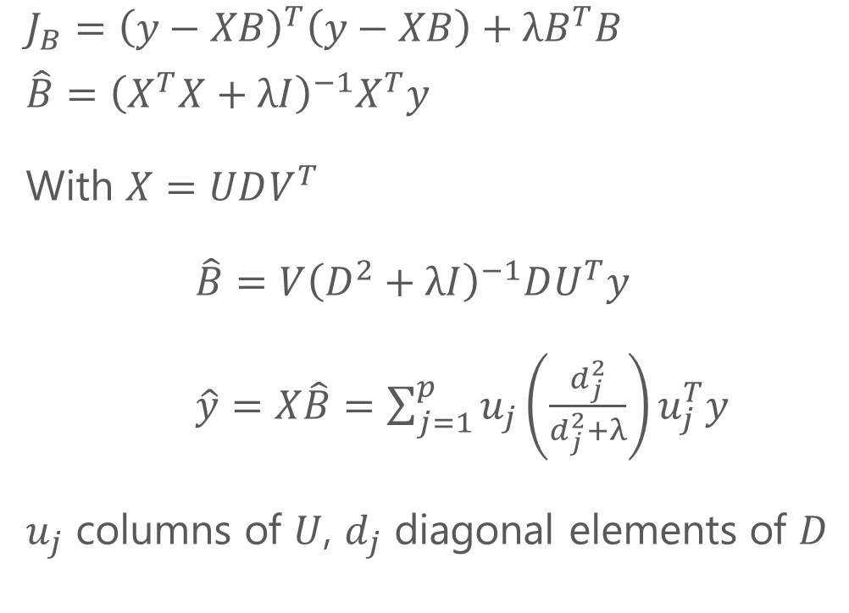
Ridge Regression
$$J_{B}={\left(y−XB\right)}^{T}\left(y−XB\right)+λB^{T}B$$
$$\hat{B}={\left(X^{T}X+λI\right)}^{−1}X^{T}y$$
With $X=UDV^{T}$
$\hat{B}=V{\left(D^{2}+λI\right)}^{−1}DU^{T}y$
$\hat{y}=X\hat{B}=\sum_{j=1}^{p}{u_{j}}\left(\frac{d_{j}^{2}}{d_{j}^{2}+λ}\right)u_{j}^{T}y$
$u_{j}$ columns of $U$, $d_{j}$ diagonal elements of $D$
Ref: SVD Tutorial

Slide 9
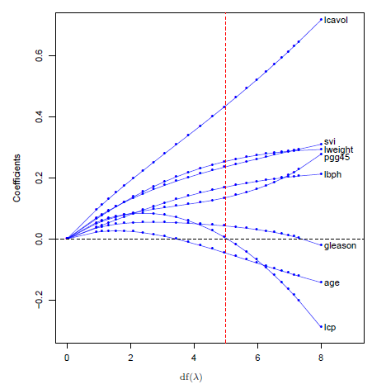
Ridge Regression

Slide 10
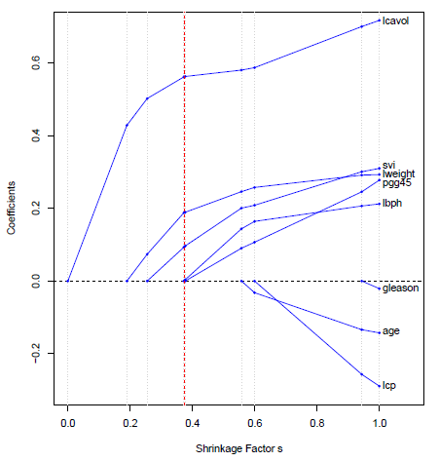
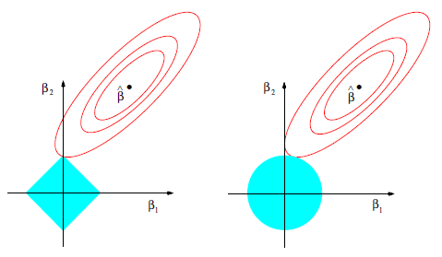

Lasso Regression
$$J_{B}={\left(y−XB\right)}^{T}\left(y−XB\right)+λ\sum_{j=1}^{p}{\left|B_{j}\right|}$$
Lasso
Ridge

Slide 11
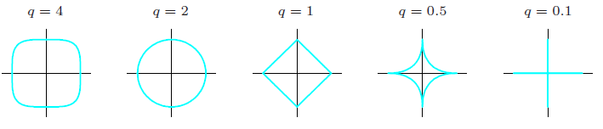

G-Formula
$$J_{B}={\left(y−XB\right)}^{T}\left(y−XB\right)+λ\sum_{j=1}^{p}{{\left|B_{j}\right|}^{q}}$$
Elastic Net

Slide 12
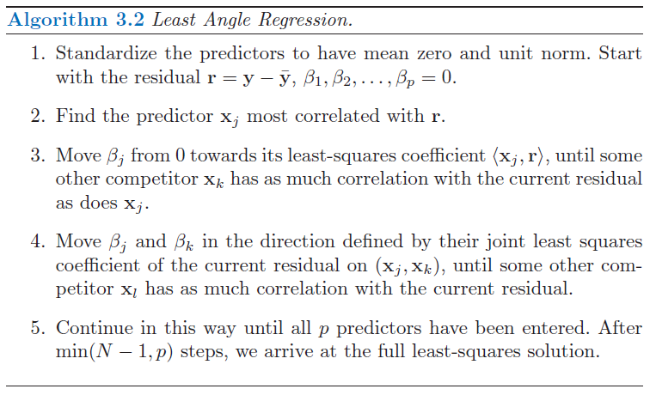
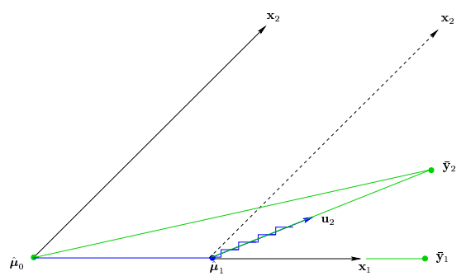
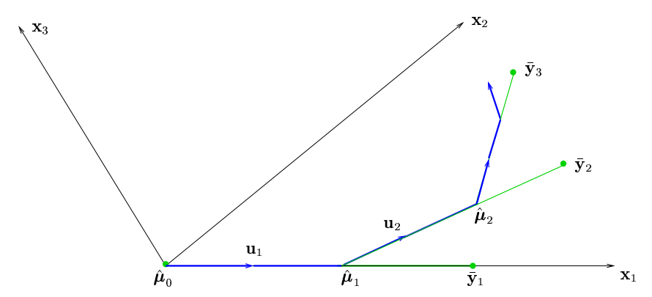
Lasso Solution – Least Angle Regression (LAR)

Slide 13
Questions?

Slide 14
2. RANDOM FOREST

Slide 15
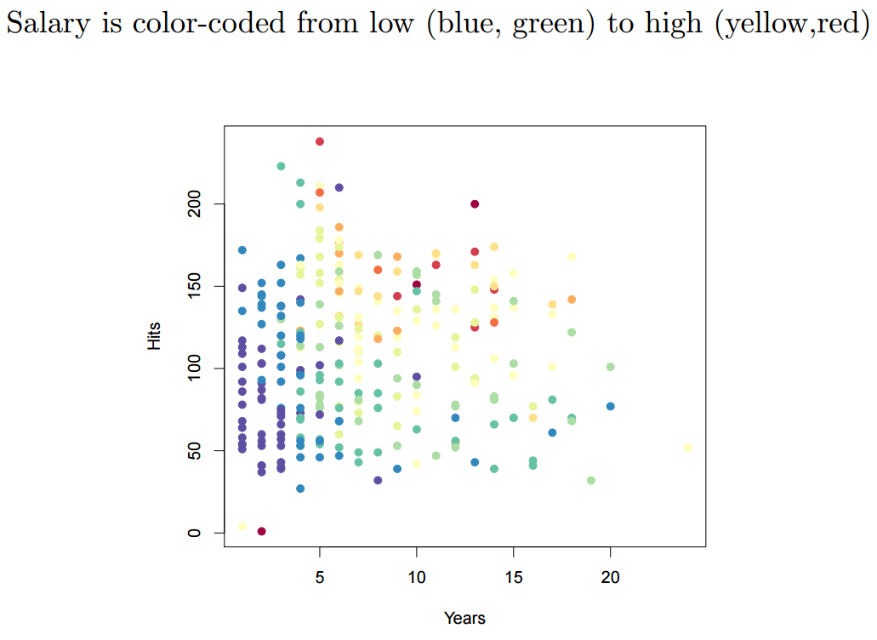
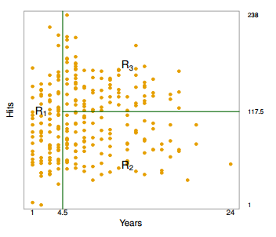
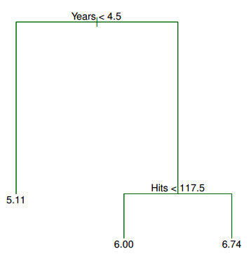
Decision Tree

Slide 16
Decision Tree
An approach that is known as recursive binary splitting
Top-down,
Greedy
Predict the response for a given test observation using the mean of the training observations in the region

Slide 17
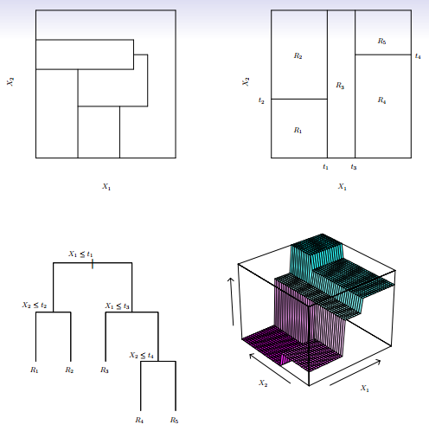
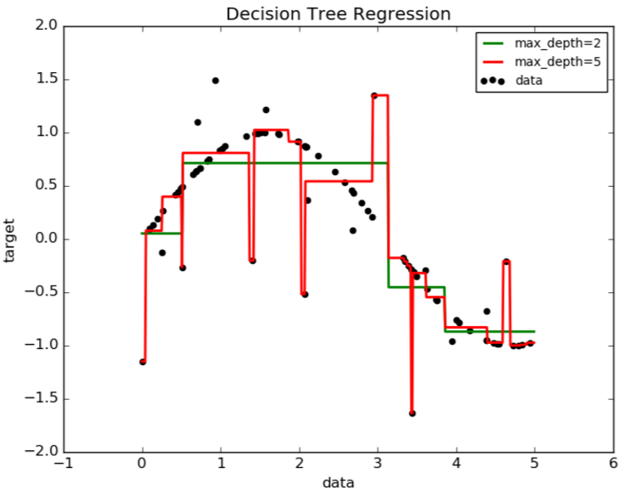
Tree Complexity and Overfitting

Slide 18
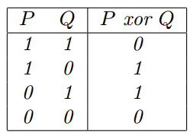
Tree Pruning
Motivation: Simple tree is too biased. Complex tree is overfitting.
Naïve solution: grow the tree only so long as the decrease in the RSS due to each split exceeds some (high) threshold.
Result in smaller trees, but is too short-sighted: a seemingly worthless split early on in the tree might be followed by a very good split
XOR

Slide 19
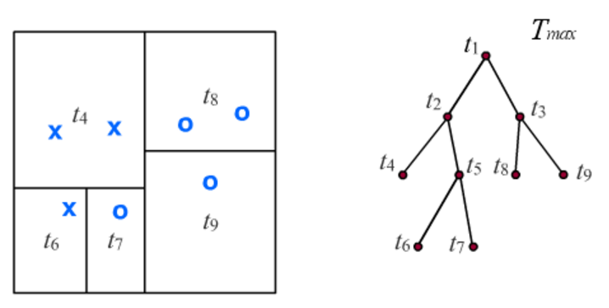
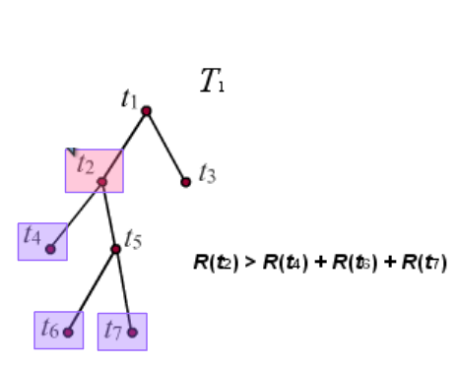
Tree Pruning
Which split can you safely remove?
Motivation: Simple tree is too biased. Complex tree is overfitting.
Better solution: grow a large tree, then merge back nodes to obtain a smaller tree of the right size link
0.25 > 0 + 0 + 0

Slide 20
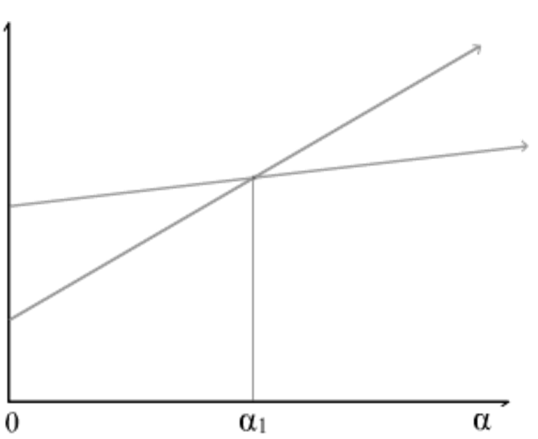

Cost complexity pruning (or Weakest link pruning)
Define $T_{t}$ a branch rooted at a node $t$, and and ${\tilde{T}}_{t}$ is its set of terminal nodes.
Let $α$ be a regularization parameter.
$$R_{α}\left(t\right)=R\left(t\right)+α∗1$$
$$R_{α}\left(T_{t}\right)=\sum_{t^{′} in {\tilde{T}}_{t}}{R(t^{′})}+α∗\left|{\tilde{T}}_{t}\right|$$
$$α_{∗}=\frac{R\left(t\right)−R(T_{t})}{\left|{\tilde{T}}_{t}\right|−1}$$
*

Slide 21

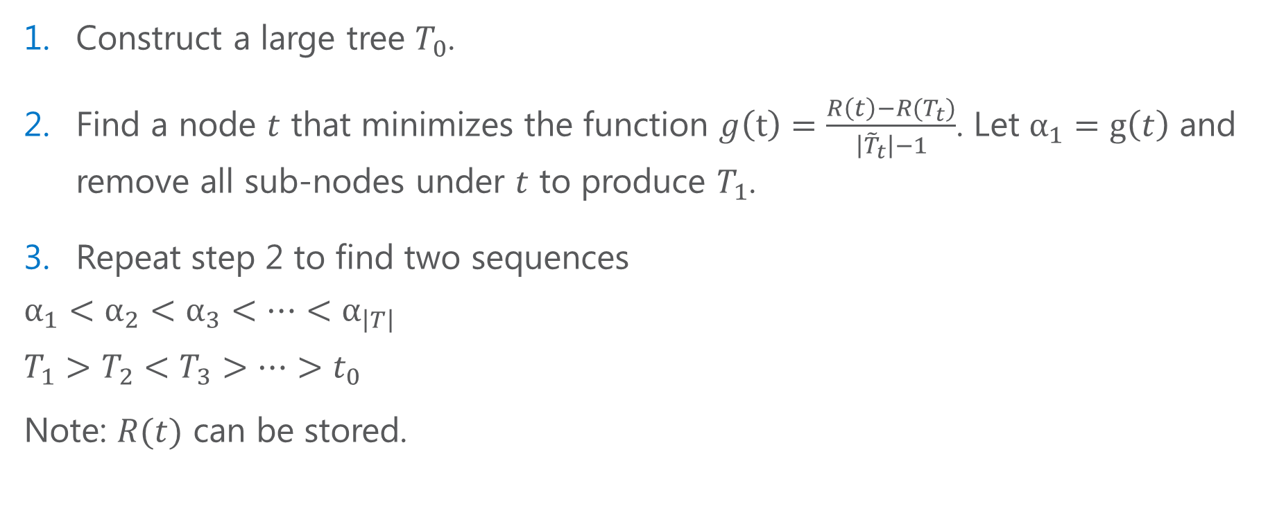
Cost complexity pruning (or Weakest link pruning)
Construct a large tree $T_{0}$.
Find a node $t$ that minimizes the function $g\left(t\right)=\frac{R\left(t\right)−R(T_{t})}{\left|{\tilde{T}}_{t}\right|−1}$. Let $α_{1}=g\left(t\right)$ and remove all sub-nodes under $t$ to produce $T_{1}$.
Repeat step 2 to find two sequences
$$α_{1}<α_{2}<α_{3}<…<α_{\left|T\right|}$$
$$T_{1}>T_{2}<T_{3}>…>t_{0}$$
Note: $R(t)$ can be stored.
$$t_{0}$$

Slide 22
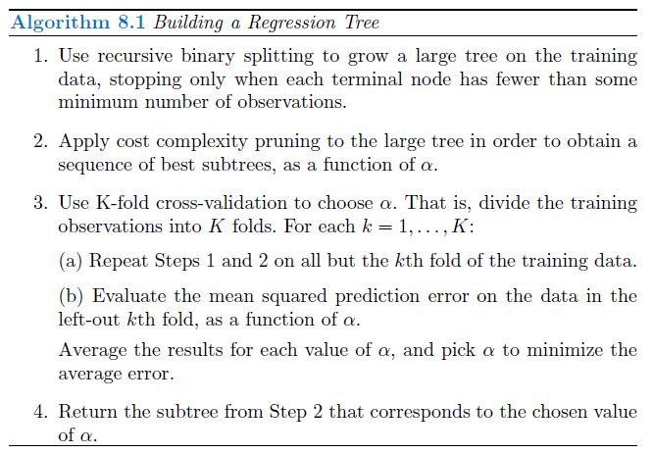
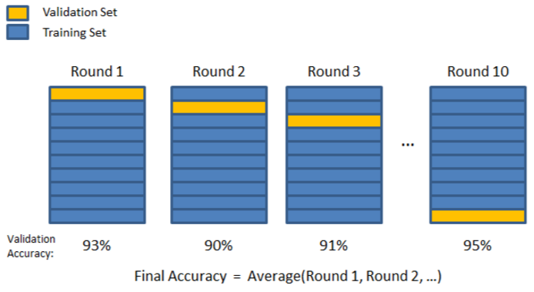
Single Decision Tree

Slide 23

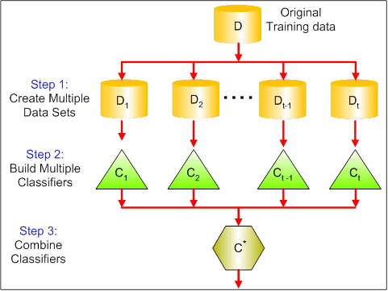


Bagging

Slide 24
Bagging – Prediction
Averaging predictions from multiple trees, each is constructed on one part of a training data set. Famous method: Bootstrap (sampling with replacement).

Slide 25
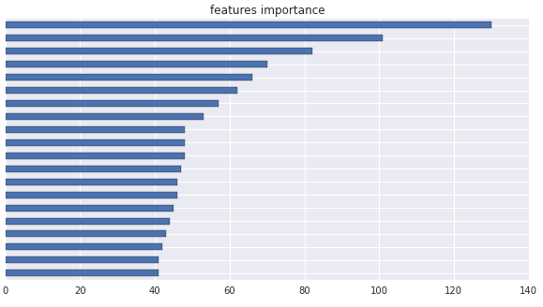
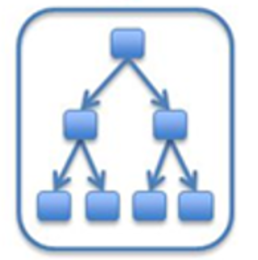
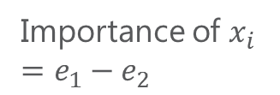






Bagging – Variable Importance
At each tree
Sum-up
$$x_{1}$$
$$x_{2}$$
$$x_{3}$$
.
.
.
$$e_{1}$$
$$x_{i}$$
Importance of $x_{i}$
$$=e_{1}−e_{2}$$
$$e_{2}$$

Slide 26




Random Forest

Slide 27
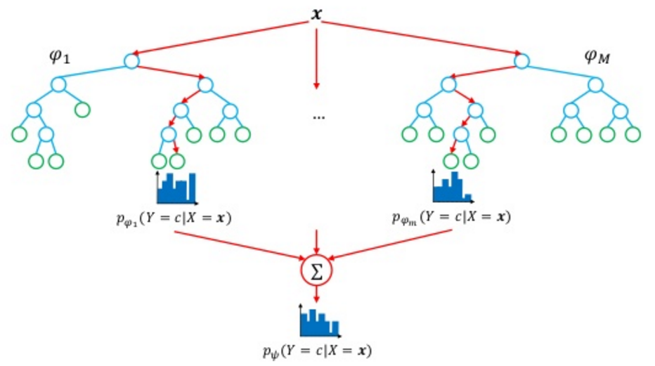
Random Forests
Randomization
Bootstrap samples
Variable selection for each tree

